Slide 1

TELECOM CUSTOMER CHURN
ANALYSIS
prepared by R a h u l Reddy

Slide 2

About the project: A detailed description of the project.
About the Data: Introduction to a dataset that has been used for the project.
Insights to find: What are the objectives & insights that are to be found out?
Steps for EDA & Cleaning Data: Various steps are used for data cleaning & EDA process.
Visual Analytics: Different visuals & summaries to understand data well.
Key Findings: Insights we find out
according to various questions.
Dashboard View: The view of a dashboard that has been created.
Agenda

Slide 3


ABOUT PROJECT
The telecom company provides telecom services to many clients. But due to many reasons. customers switch from one service provider to other. Telecom churn has emerged as the single largest cause of revenue erosion for telecom operators.
Now telecom company manager wants to know actionable insights to
retain customers and increase customers’ lifetime values.
Here in this project we have to analyse a huge dataset from which we are going to extract actionable insights & make a Dashboard that can be useful for a Sales manager to work on and see how our business is doing. Also, he can make data-driven decisions & which will help him to retain customers and increase customers’ lifetime values.
We have extracted many different insights which we will see further in this report.

Slide 4

ABOUT DATA SET
Each row represents a customer and each column contains the customer attributes described in the column metadata.
The dataset shows the customer’s account details like customer id, gender, senior citizen, partner and whether dependent on someone or not.
It shows various services that each customer has signed up like phone service, tenure, Multiple lines, internet service, online security & backup, device protection, streaming TV & movies and tech support.
It also shows customer account information like a contract, payment method, paperless billing, monthly charges and total charges.
Customer who left this column is called Churn.

Slide 5


INSIGHTSTO BE FOUND
What are the number of male & female customers in the entire customer and churner profile?
What is the number of senior citizens & non-senior citizens in the entire customer and churner profile?
What are monthly charges & total charges for the entire customer and churner profile?
What are the percentages of churn and
retain customers?
What are demographic-wise gender-by- tenure bins for the entire customer and churner profile?
What is the percentage of gender by tenure
& connection with and without a partner?

Slide 6

INSIGHTSTO BE FOUND
What is the percentage of male & female customers by contract
in customer and churner profile?
What is the percentage of senior & non-senior citizens for entire customers and churner profiles?
What is gender distribution and how is gender related to churn?
What is the percentage of contracts by gender in entire customers and churner profiles?
What is the distribution of the contract by monthly charges and
total charges?
What is the distribution of tenure bins by monthly charges and total charges?

Slide 7

INSIGHTSTO BE FOUND
What is the percentage of customers with department and partner in customers and churner profile.?
What is the chance of churn based on payment method?
What is the percentage of internet services by gender?
What is the percentage of customers who deposit online security?
What is the percentage of multiple lines connected by gender?
What is the chance of churn based on the bil delivery method?
What is the percentage of technical support by gender?
What is the chance of churn based on dependents?
What is the chance of churn based on device protection?

Slide 8
Import data from Excel into Power BI.
There are null values in the monthly charges column, replace them with 0 values using replace options in Power BI.
In total charge replace the null value with zero.
Change value data type in decimal to fixed decimal number format
in the monthly & total charges column.
Using derived metrics to create tenure bins.
Add a conditional column option in Power BI. Then name this column as tenure bins and add a clause like If column name tenure Operator greater than or equal to Value 61 Output 61-100.
Else if Column name tenure greater than or equal to Value 41 Output 41-60.
Else if Column name tenure greater than or equal to Value 21 Output 21-40.
Else if Column name tenure greater than or equal to Value 0 Output 0-20.
Duplicate the data of telco customer churn and rename the data as Churn.
Filter the “churn” column and then keep Yes only. So we get only
the churn dataset.
STEPS FOR CLEANING DATA AND EDA

Slide 9























Telecom Customer Profile
Retained
VISUAL ANALYTICS AND FINDINGS
Customers
7043
73.46%
Male Profile
3555
Female Profile
3488
Monthly charges(Avg)
$64.76
Total charges (Avg)
$2283
Here we can see the entire telecom customers profile for males, and females profile, monthly charges (average) & total charges (average).
In the entire telecom customer profile about 7043 customers
are there. Out of that 1869 customers are churning.
In the entire customer profile about 3555 male customers are there. Out of that, 930 customers are churned.
In customer profile. monthly charges (average) were $64.76. But
in the churner profile. monthly charges (average) were $74.44.
In customer profile. total charges (average) was $2283. But in the churner profile. monthly charges (average) were $1522.
In telecom analysis 73.46% of retained customers are there & 26.54% of churn customers are there.
Churn Customers Profile
1869
Male Profile 930
Female Profile 939
Monthly charges
$74.44
Total charges
$1532
Churn
Customers
26.54%

Slide 10
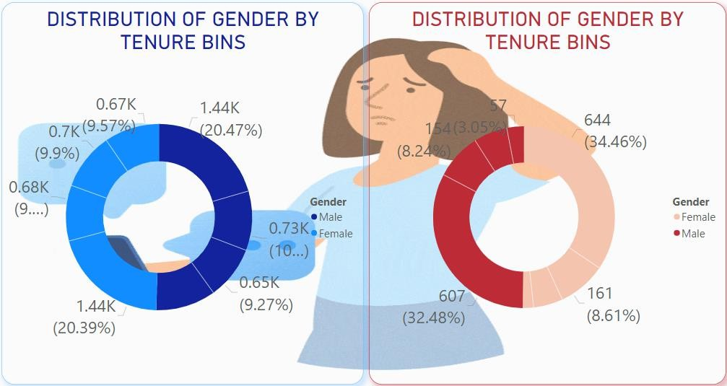
From this graph we can observe the entire customer’s telecom
dataset & churner profile demographic in detail.
In the entire customer profile 0-20 age male contribution is 1.44k
(20.47%) but in the churner profile it’s 607(32.48%).
So compared with percentage wise it’s more number of churners
there.
In the entire customer profile 21-40 age male contribution is 0.73k
(10.32%) but in the churner profile it’s 154(8.24%).
So compared with percentage wise it’s less than no of churner are
there.
In the entire customer profile 41-60 age male contribution is 0.67k
(9.27%) but in the churner profile it’s 112(5.99%).
In the entire customer profile 61-100 age male contribution is 0.74k
(10.41%) but in the churner profile it’s 57(3.05%).
So compared with percentage wise it’s less no churners are there.
DEMOGRAPHIC WISE GENDER BY TENURE BINS

Slide 11
in churner profile its 644(34.46%).
In telco profile 0-20 age female contribution is 1.44k (20.39%) but
So compared with percentage wise it’s more churner there.
In the entire customer profile 21-40 age male contribution is
0.68k (9.6%) but in the churner profile it’s 161(8.61%).
So compared with percentage wise its less no of churner is there.
In the entire customer profile 41-60 age male contribution is 0.7k
(9.9%) but in the churner profile it’s 98(5.24%).
In the entire customer profile 61-100 age male contribution is
0.67k (9.57%) but in the churner profile it’s 36(1.93%).
So compared with percentage wise it’s less no churners are there.
Compared with males. 0-20 age female contribution is of churner is more.
DEMOGRAPHIC WISE GENDER BY TENURE BINS

Slide 12
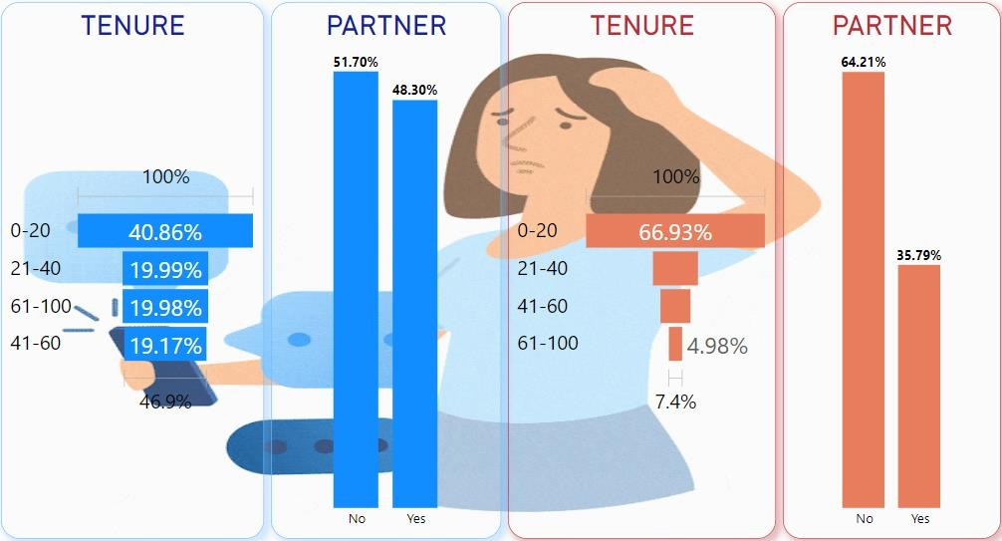
From this graph we can observe the entire customer data Tenure,
Partner of customer & churner profile in detail.
In the entire customer profile, the 0-20 age group are 2878 (40.86%).
Whereas in the churner profile, it’s 1251 (66.93%).
So this age group tends to churn more than others groups. customer profiles, 21-40 age males & females are 1408 (19.99%). Whereas in the churner profile, it’s 315 (16.85%).
In telco customer profiles, 41-60 age male & female are 1350
(19.17%). Whereas in the churner profile, it’s 210(11.24%).
In
In customer profiles, 61-100 aged male & female are 1407 (19.98%).
Whereas in the churner profile, it’s 93 (4.98%).
In telco customer profile, 3402(51.70%)customers connection are with partner & 3641(51.70%) are without partner. Whereas in the churner profile, 669(35.79%) customers connected are with a partner & 1200(64.21%) customers connected are without a partner.
So without partner customers or living alone tend to churn more.
WHAT ISTHE % OF GENDER BYTENURE & TELECOM CONNECTION WITH & WITHOUT A PARTNER

Slide 13
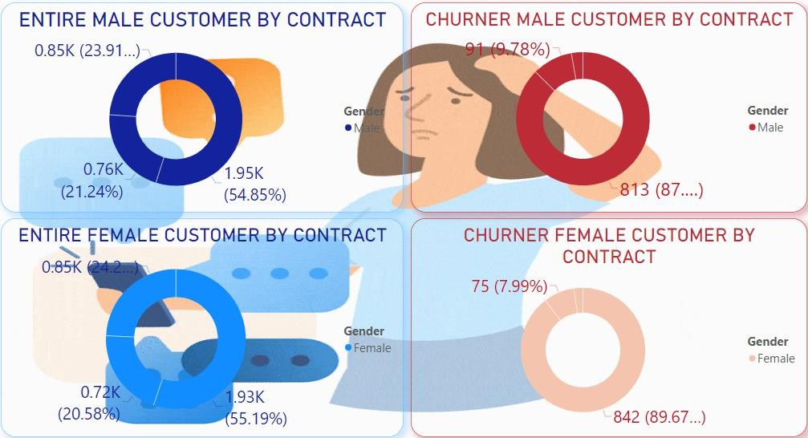
of male and female customers.
From this graph we can observe. The dataset has an almost equal distribution
In the entire customer profile, male age group MOM customers are 1.95k
(54.85%). Whereas in the churner profile, it’s 813 (87.42%).
So MOM contract male customers tend to churn more than others contracts. In the customer profile, Yearly are 0.76k (21.24%). Whereas in the churner profile, it’s 91 (9.78%).In the entire customer profile, 41-60 age male age group 2 Year customers are 0.85k (23.91%). Whereas in the churner profile, it’s 26(2.8%).
In the entire customer profile, female age group MOM customers are 1.93k
(55.19%). Whereas in the churner profile, it’s 842 (89.67%).
So MOM contract female customers tend to churn more than male customers and other contracts.
In customer profile, Yearly are 0.72k (20.58%). Whereas in the churner profile,
it’s 75 (7.99%).In the entire customer profile, 41-60 age female age group 2 Year customers are 0.85k (24.23%). Whereas in the churner profile, it’s 2(0.31%).
WHAT ISTHE % OF MALE & FEMALE CUSTOMERS BY CONTRACT

Slide 14
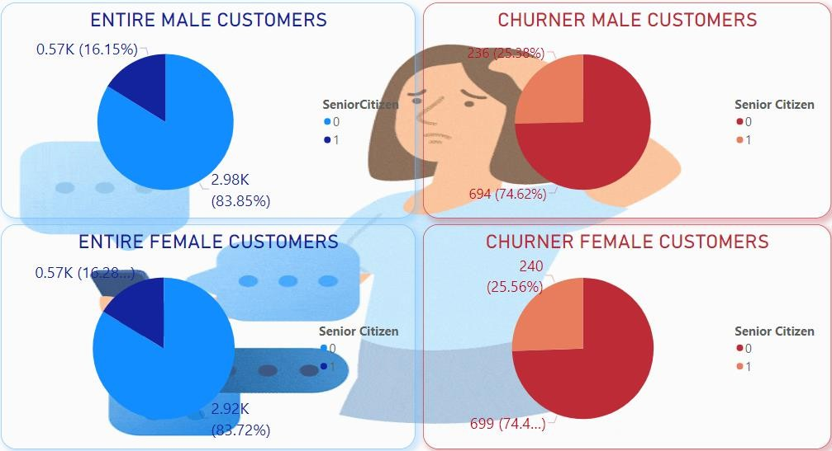
equal distribution of male and female young & old customers.
From this graph we can observe. The dataset has an almost
In the entire customer profile, male young group customers are
2.98k (54.85%). Whereas in the churner profile, it’s 694 (74.62%).old group customers are 0.57k (16.15%). Whereas in the churner profile, it’s 236 (25.38%).
In the entire customer profile, female young group customers are 2.92k (83.72%). Whereas in the churner profile, it’s 699 (74.44%).old group customers are 0.57k (16.28%). Whereas in the churner profile, it’s 240 (25.56%).
Majority of the customers in the dataset are Non-Senior Citizens.
Out of all senior citizen customers, more than 40% churn. While among younger customers, the churn percentage is less than 25%. Hence, senior citizens tend to churn more than younger customers
WHAT ISTHE % OF SENIOR & NON SENIOR CITIZEN CUSTOMERS

Slide 15
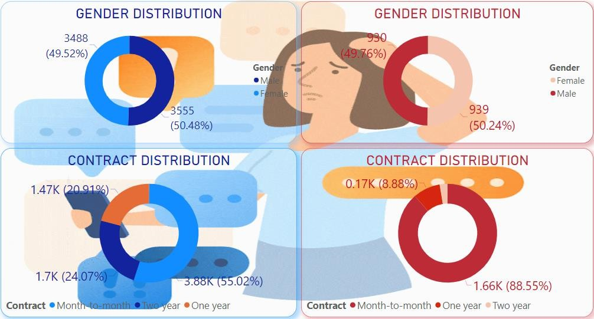
From this graph we can observe. The dataset has an almost equal distribution
of male and female customers.
In gender distribution. entire customer profile, male customers are 3555 (50.48%) & female customers are 3488 (49.52%). Whereas in the churner profile, it’s 3488 (49.52%). Whereas in the churner profile, male customers are 930 (49.76%) & female customers are 939 (50.24%).
In contract distribution. entire customer profile, MOM total customers are
3.88k (55.02%) & retained customers are 19.41 %. Whereas in the churner
profile, it’s 1.66k (88.55%) %) & churn customers are 23.5 %.
So MOM contract customers tend to churn more than other contracts.
Yearly contract are 1.47k (20.91%) & retained customers are 22.9 %. Whereas in the churner profile, it’s 0.17k (8.88%) & churn customers are 2.36 %. 2 Year contract customers are 1.7k (24.07%) & retained customers are 31.15 %.
Whereas in the churner profile, it’s 48(2.57%) & churn customers are 0.68 %.
We observe that the churn rate is a bit thinner for very long-tenure customers.
WHAT ISTHE % OF GENDER & CONTRACT DISTRIBUTION AND
HOW IS GENDER RELATEDTO CHURN

Slide 16
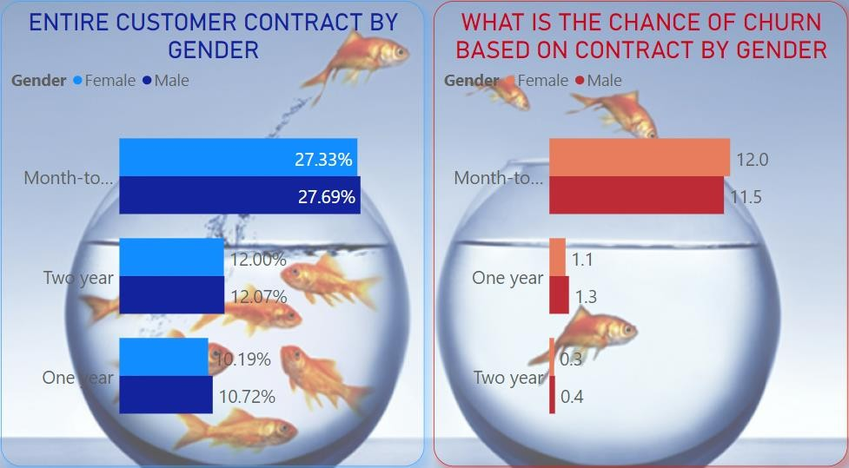
distribution of male and female customers.
From this graph we can observe. The dataset has an almost equal
In contract by gender distribution. entire customer profile, MOM total male customers are 27.69% & female customers are 27.33%. Whereas in the churner profile, male customers are 11.5% & female customers are 12%.
The churn rate is high among monthly customers
In Yearly contract distribution. entire customer profile, male customers are 10.72% & female customers are 10.19%. Whereas in the churner profile, male customers are 1.3% & female customers are 1.1%.
In 2 Yearly contract distribution. entire customer profile, male customers are 12.07% & female customers are 12%. Whereas in the churner profile, male customers are 0.4% & female customers are 0.3%.
We observe that the churn rate is a bit thinner for very long-tenure customers.
WHAT ISTHE % OF CONTRACT BY GENDER

Slide 17
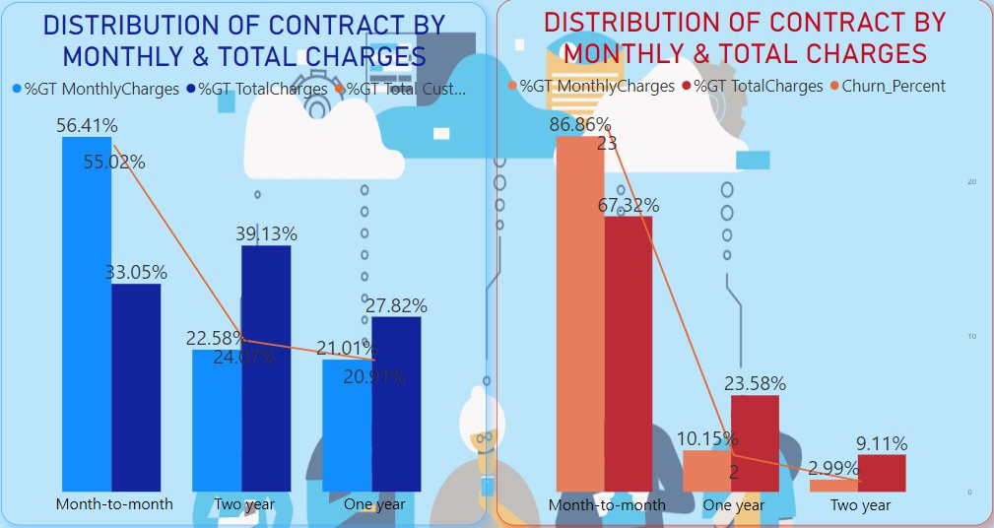
In the entire customer profile. MOM contract monthly charges are 56.41%, total charges are 33.05% and total customers are 55.02%. Whereas in churner profile. MOM monthly charges are 86.86%, total charges are 67.32% and total customer churn is 23%.
The MOM contract monthly charges contribution is high among yearly & 2 yearly customers and also total customers are higher.
In the yearly contract monthly charges are 21.01%, total charges are 27.82% and total customers are 20.91%. Whereas in churner profile. Monthly charges are 10.15%, total charges are 23.58% and total customer churn is 2.36%.
In 2 yearly contracts monthly charges are 22.58%, total charges are 39.13% and total customers are 24.07%. Whereas in churner profile. Monthly charges are 2.99%, total charges are 9.11% and total customer churn is 0.68%.
This shows that the customers taking a longer contract are more loyal to the company and tend to stay with it for a longer period of time.
WHAT ISTHE DISTRIBUTION OF CONTRACT BY MONTHLY ANDTOTAL CHARGES

Slide 18
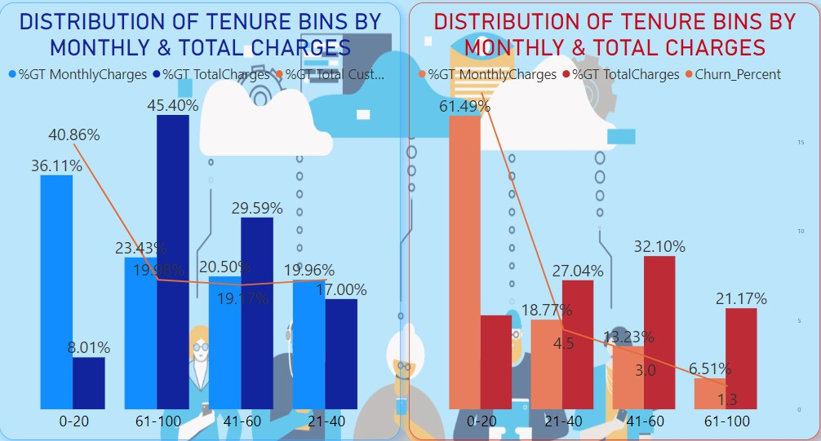
In the entire customer profile. 0-20 age monthly charges are 36.11%, total charges are 8.01% and total customers are 40.86%. Whereas in churner profile. 0-20 age monthly charges are 61.49%, total charges are 19.70% and churn customers ratio is 17.76%.
So 0-20 age group customers contribution has more monthly charges and also churn ratio are more.
In the 21-40 age monthly charges are 19.96%, total charges are 17% and total customers are 19.99%. Whereas in churner profile. 21-40 age monthly charges are 18.77%, total charges are 27.04% and churn customers ratio is 4.47%.
In 41-60 age monthly charges are 20.5%, total charges are 29.59% and total customers are 19.17%. Whereas in churner profile. 41-60 age monthly charges are 13.23%, total charges are 32.1% churn customers ratio is 2.98%.
WHAT ISTHE DISTRIBUTION OFTENURE BINS BY MONTHLY ANDTOTAL CHARGES

Slide 19
45.4% and total customers are 19.98%.
In 61-100 age monthly charges are 23.43%, total charges are
Whereas in churner profile. 61-100 age monthly charges are 6.51%, total charges are 21.17% churn customer ratio is 1.32%.
So 61-100 age customers contribution of total charges are more than others age group.
Majority of customers have lower total charges. The highest churn rate is observed among such customers.
This shows that the customers taking a longer contract are more loyal to the company and tend to stay with it for a longer period of time.
WHAT ISTHE DISTRIBUTION OFTENURE BINS BY MONTHLY ANDTOTAL CHARGES

Slide 20
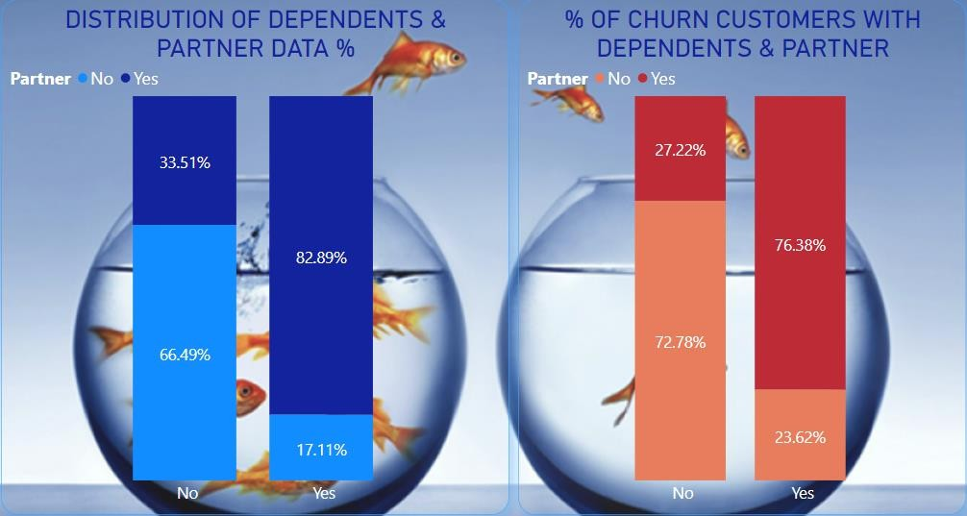
Customers who do not have dependents & partners, that type of customer churned percentage ratio was 15.94%.
Customers who do not have dependents but have partners, that type of customer churned percentage ratio was 5.96%.
Customers who have both dependents & partners, that type of customer churned percentage ratio was 3.54%.
Customers who have both dependents & and do not have partners, that type of customer churned percentage ratio was 1.09%.
Customers who do not have any dependents & partners, that type of customers are tending to churn more.
WHAT ISTHE PERCENTAGE OF CUSTOMERS WITH DEPENDENTS & PARTNER

Slide 21
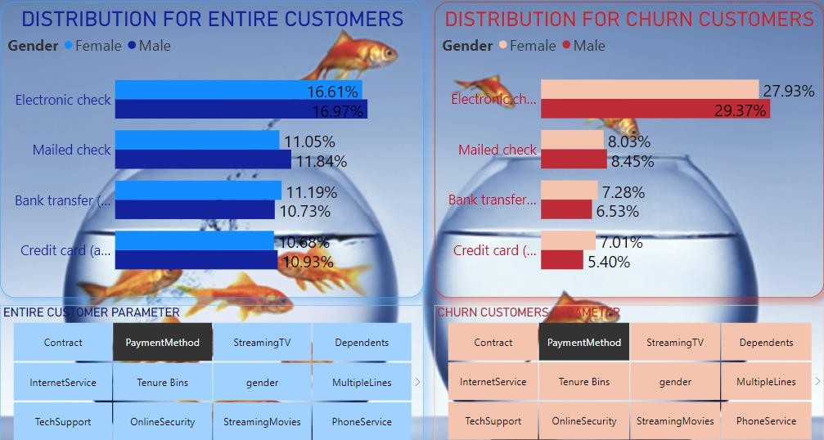
The visuals show clustered bar chart in which we can see a percentage of churn by payment method.
Customers who use the electronic check payment method, that type of customer churned percentage ratio was 15.2%.
Customers who use the mailed check payment method, that type of customer churned percentage ratio was 4.4%.
Customers who use bank transfer(automatic) payment method,
that type of customer churned percentage ratio was 3.7%.
Customers who use credit card(automatic) payment method, that type of customer churned percentage ratio was 3.3%.
Customers with payment method as "Electronic Check" is higher than customers with other modes of payment method.
In electronic check & mailed check payment methods “Male" customers are slightly churned more as compared to female customers.
WHAT ISTHE CHANCE OF CHURN BASED ON PAYMENT METHOD

Slide 22
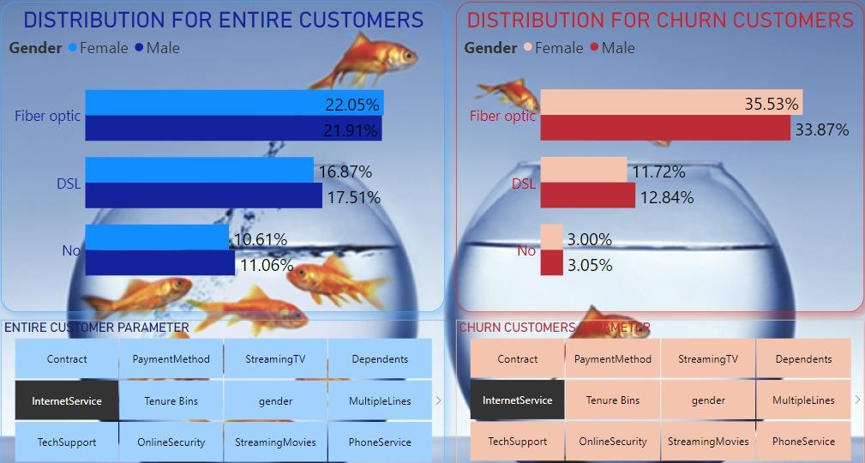
The visuals show clustered bar chart in which we can see the percentage of churn by internet service.
Customers who use fibre optic internet service, that type of customer churned percentage ratio was 18.42%.
Customers who use DSL internet service, that type of customer churned percentage ratio was 6.52%.
Customers who do not use any internet service, that type of
customer churned percentage ratio was 1.60%.
Customers with internet service as “Fiber Optic" is higher than
customers with other modes of internet service.
In Fiber optic internet service “Female" customers are slightly churned more as compared to male customers.
But in DSL internet service “Male" customers are slightly churned more as compared to female customers.
WHAT ISTHE CHANCE OF CHURN BASED ON INTERNET SERVICE

Slide 23
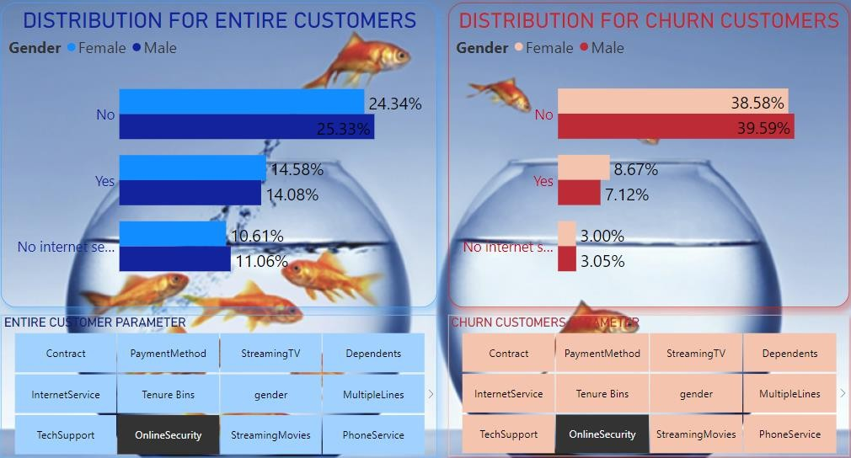
The visuals show clustered bar chart in which we can see a percentage of churn by online security.
Customers who do not use online security services, that type of customer churned percentage ratio was 20.74%.
Customers who use online security services, that type of customer churned percentage ratio was 4.19%.
Customers who do not use any internet service, that type of
customer churned percentage ratio was 1.60%.
So the customers who do not use online security services are churned more.
Those who do not use online security services that “Male" customers are slightly churned more as compared to female customers.
Also who use online security services, “Female" customers are slightly churned more as compared to male customers.
WHAT ISTHE CHANCE OF CHURN BASED ON ONLINE SECURITY

Slide 24
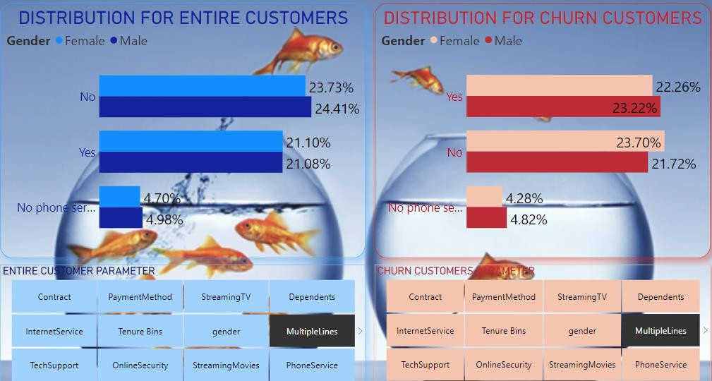
The visuals show clustered bar chart in which we can see a percentage of churn by multiple lines.
Customers who use multiple lines connection, that type of customer churned percentage ratio was 12.07%.
Customers who use single line connection, that type of customer churned percentage ratio was 12.05%.
Customers who do not use any phone service, that type of
customer churned percentage ratio was 2.41%.
So the customers who have multiple lines connections churn more than single-line connection service.
Those who use multiple lines connection that “Male" customers are slightly churned more as compared to female customers.
Also who does not use multiple lines connection, “Female" customers are slightly churned more as compared to male customers.
WHAT ISTHE CHANCE OF CHURN BASED ON MULTIPLE LINES CONNECTION

Slide 25
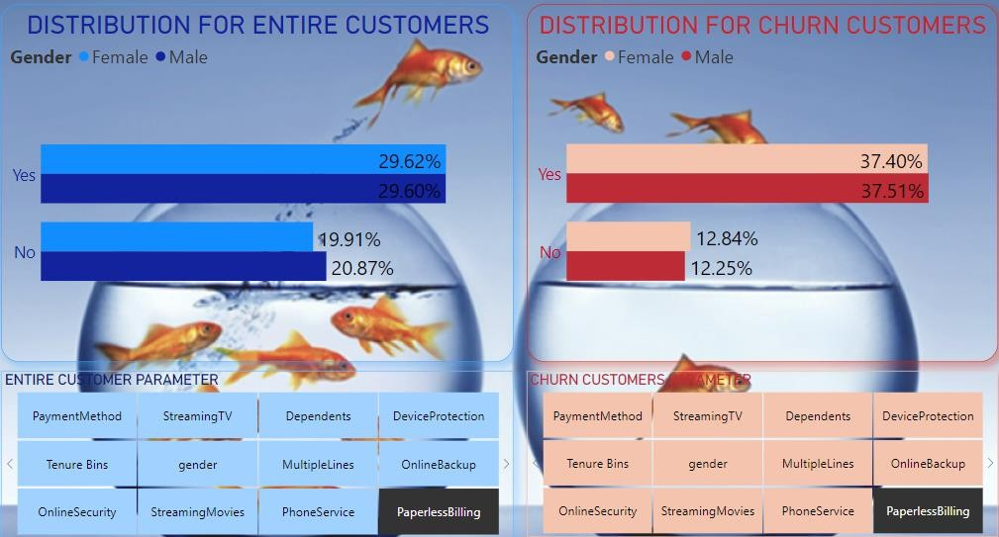
The visuals show clustered bar chart in which we can see a percentage of churn by paperless bill delivery method.
Customers who use paperless billing, that type of customer churned percentage ratio was 19.88%.
Customers who do not use paperless billing, that type of customer churned percentage ratio was 6.66%.
Customers who use paperless billing methods that type of customers tend to churn more.
Those who use paperless billing “Male" customers are slightly churned more as compared to female customers.
WHAT ISTHE CHANCE OF CHURN BASED ON THE BILL DELIVERY METHOD

Slide 26
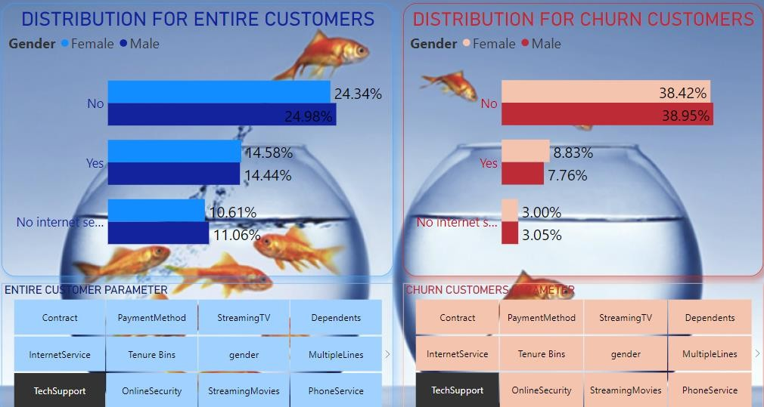
The visuals show clustered bar chart in which we can see a percentage of churn by technical support.
Customers who do not use technical support, that type of customer churned percentage ratio was 20.53%.
Customers who use technical support, that type of customer churned percentage ratio was 4.40%.
Customers who do not use any internet service, that type
of customer churned percentage ratio was 1.6%.
Customers who do not use technical support that type of customers tend to churn more.
Those who use technical support that “Female" customers are slightly churned more as compared to male customers.
WHAT ISTHE CHANCE OF CHURN BASED ON TECHNICAL SUPPORT

Slide 27
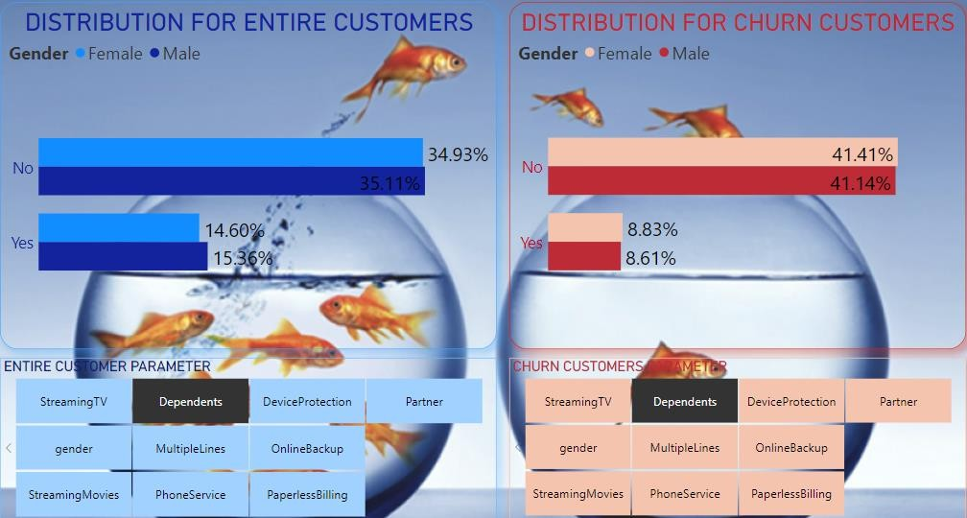
The visuals show clustered bar chart in which we can see a percentage of churn by dependents.
Customers who do not have a dependency, that type of customer churned percentage ratio was 21.91%.
Customers who have a dependency, that type of customer churned percentage ratio was 4.63%.
Customers who do not have any dependency on that type of customer tend to churn more.
Those who do not have any dependency that
“Female" customers are slightly churned more as compared to male customers.
WHAT ISTHE CHANCE OF CHURN BASED ON DEPENDENTS

Slide 28
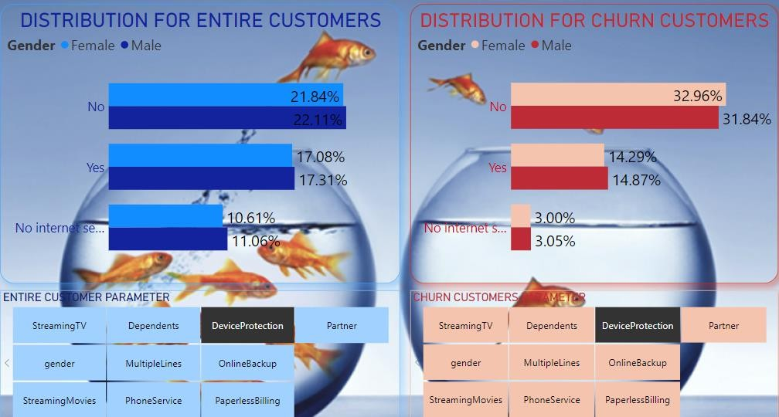
Device protection means customers stay protected beyond the standard warranty, with coverage for all accidental damage for up to 2 years & Also provides anti-virus to protect your handset and data from any attack, gives a cloud backup and even gives you insurance cover.
Customers who do not have any device protection plan, that type of customer churned percentage ratio was 17.19%.
Customers who have a device protection plan, that type of customer churned percentage ratio was 7.74%. For customers who do not use any internet service, that type of customer churned percentage ratio was 1.6%.
Customers who do not have any device protection plan, that type of customers are tended to churn more.
Those who have any device protection plan that “Female" customers are slightly churned more as compared to male customers.
WHAT ISTHE CHANCE OF CHURN BASED ON DEVICE PROTECTION

Slide 29



From the overall graph, we can observe that monthly dataset contract-type customers are more likely to be churned.
Tenure bins wise, the 0-20 age group
customer has more possibility to churn.
SUMMARY
Gender-wise, female customers, who have adopted monthly contracts have more possibility to be churned as compared to male customers.
Those who have not taken any kind of tech support, that type of customers have more possibility to be churned.
For those who use fiber optic
connections, that type of customer’s
churned percentage was high.
Those who have not deposited online security, that type of customers have more possibility to churn.

Slide 30
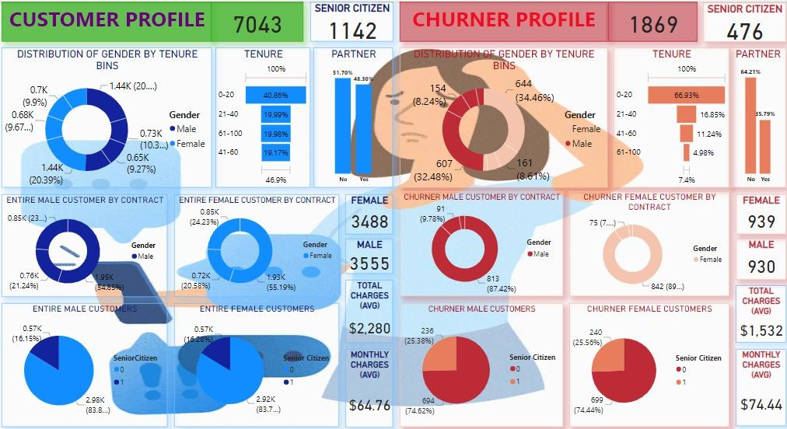
DASHBOARD PAGESVIEW

Slide 31
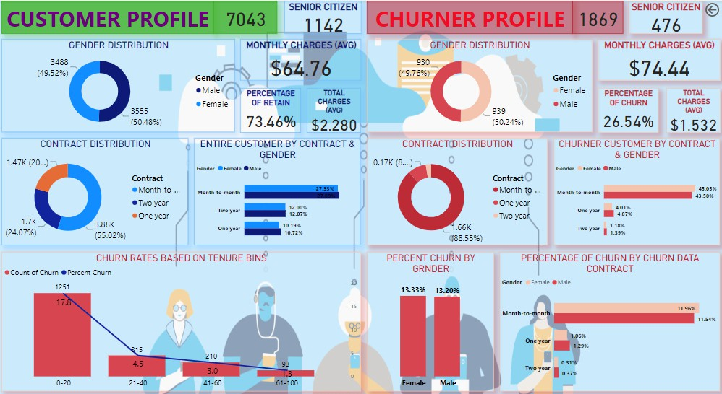
DASHBOARD PAGESVIEW

Slide 32
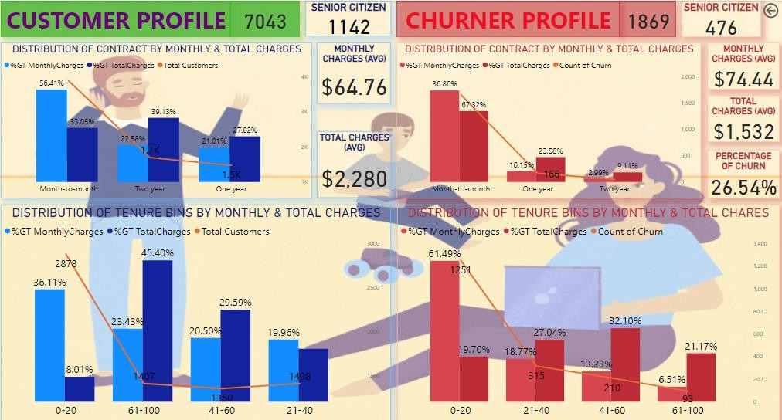
DASHBOARD PAGESVIEW

Slide 33
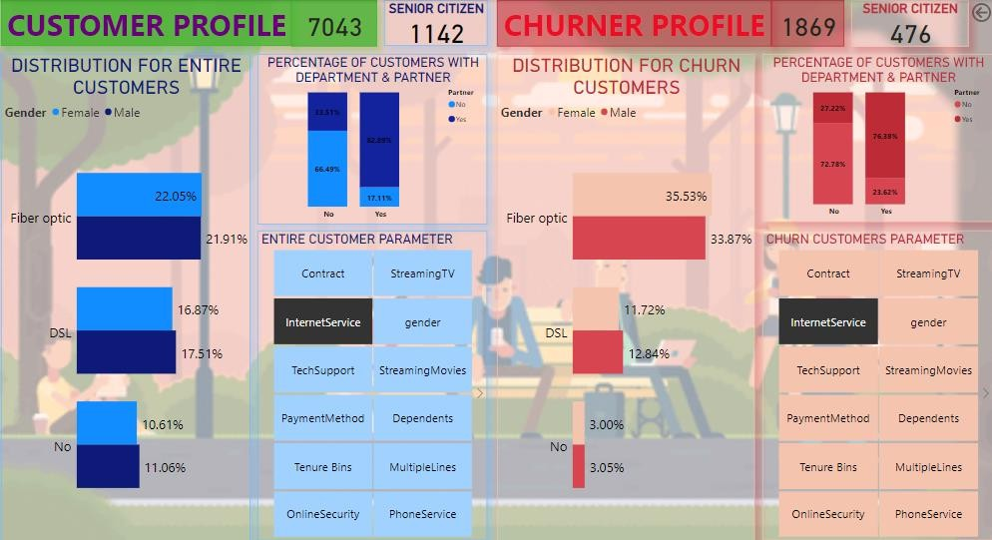
DASHBOARD PAGESVIEW

